Slide 1
NetBox Day 2020
State of the Project
Jeremy Stretch

Slide 2
Origin Story
NetBox was created to address various shortcomings of IPAM/DCIM tools available at the time
No/limited API
Missing features
Quantity-based commercial licensing
Lack of support

Slide 3
Design Philosophy
Replicate the real world
Data model is tightly coupled to real-world constraints
Function as a source of truth for the network
Use NetBox to provision devices, not vice versa
Keep things simple
High value and ease of maintenance are preferred over 100% complete solutions

Slide 4
History
Started by Jeremy Stretch as an internal PoC at DigitalOcean
John Anderson signs on as a maintainer
Repo moved to its own GitHub organization
June 2016
February 2019
September 2019
Late 2015
August 2018
June 2019
Released as open source (Apache 2)
Daniel Sheppard joins maintainers team
NTC announces commercial support for NetBox

Slide 5
Recent Additions & Changes
2.6
2.7
2.8
Power panels & feeds
Queryset caching
Model-level view permissions
Custom links
Custom scripts
Device type library
External media storage
SVG rack elevations
Removed topology maps
Remote authentication
Plugins framework

Slide 6
Plugins Framework
Primary goals
Allow extension of NetBox by end users without the need to maintain a custom fork
Allow core development to focus on NetBox’s primary use cases
Currently in beta
Further extensions planned, must be conservative in implementation

Slide 7
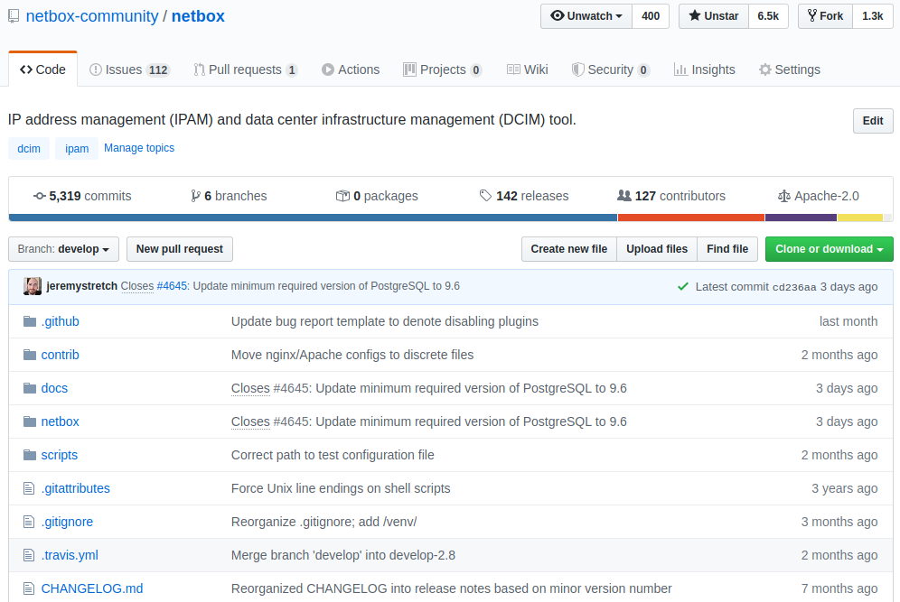
Current Stats
6,500 GitHub stars
1,300 forks
6 maintainers
127 contributors
142 releases
5,300+ commits

Slide 8
Roadmap
2.9
2.10
Beyond*
Object-oriented permissions
User UI preferences
Background execution for scripts & reports
Extension of secret assignment
VRF import/export tracking
Device component grouping/modules
Half-height rack units
Virtual chassis improvements
API-driven UI
Virtual network modeling
Wireless network modeling
* Proposals under consideration

Slide 9
Development Focus Moving Forward
Work through backlogged features
Demand vs. ease of implementation & maintenance
Bug fixes continue to be prioritized
Continue refining functional scope
Defer out-of-scope features for plugin development
Improve test scalability and coverage
API changes in support of a new UI

Slide 10
Let’s Get Started!

